Slide 1
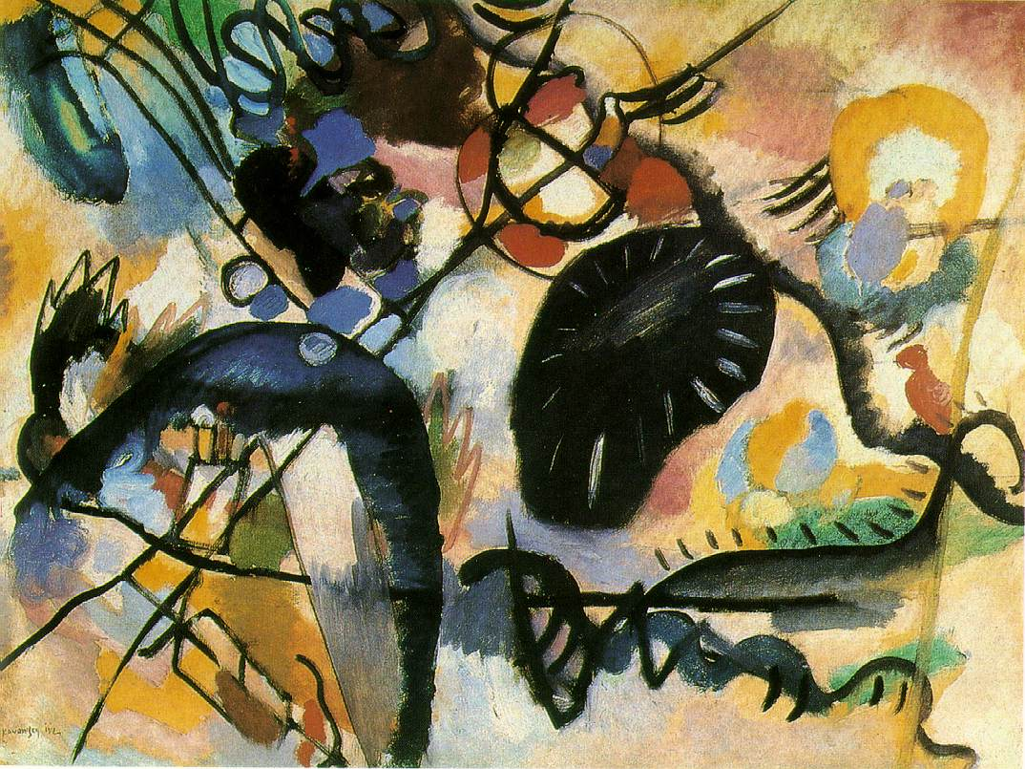
Wassily Kandinsky

Slide 2
Wassily Kandinsky- 1866-1944
Russian-born artist, one of the first creators of abstraction in modern painting.
Kandinsky was an accomplished musician and once stated that “Color is the keyboard, the eyes are the harmonies, the soul is the piano with many strings. The artist is the hand that plays, touching one key or another, to cause vibrations in the soul.” (Web Museum)
He even claimed that, “when he saw color he heard music.”

Slide 3
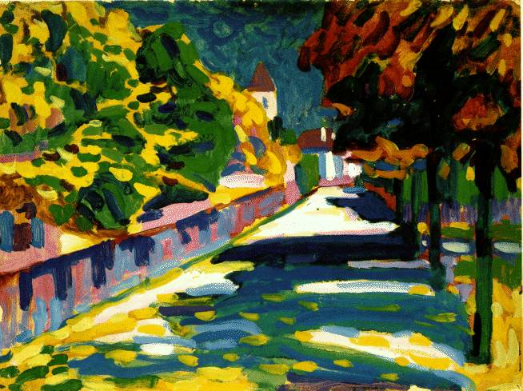
Autumn in Bavaria

Slide 4
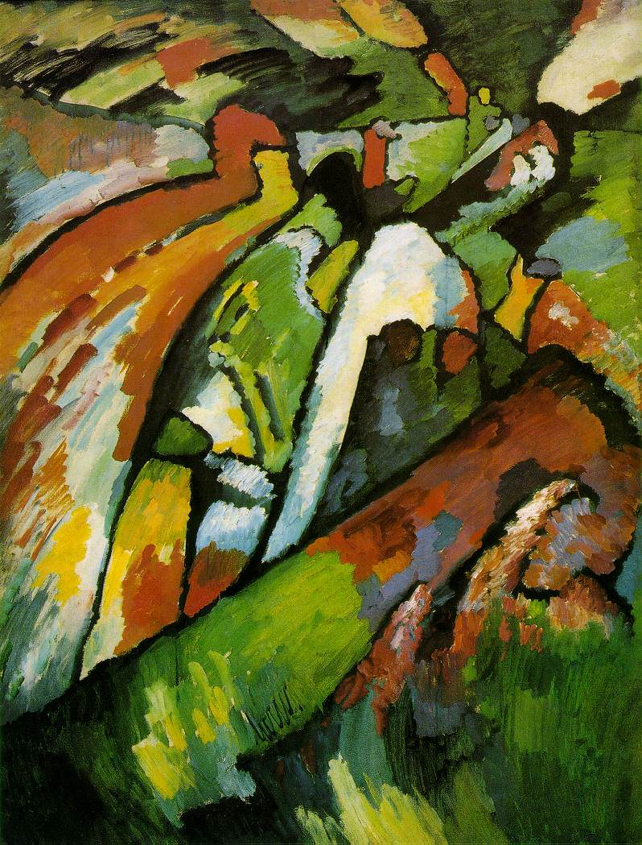
Improvisation

Slide 5
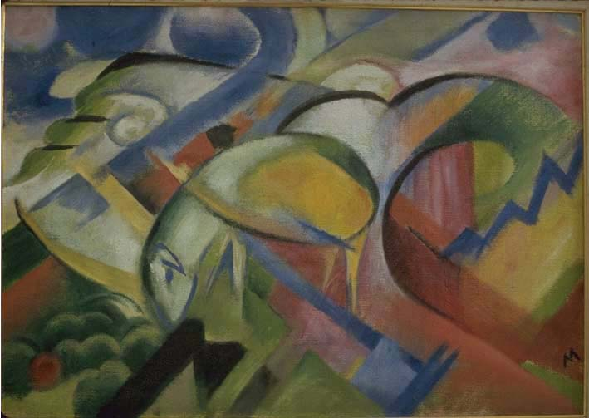
Lamb

Slide 6
Black Spot

Slide 7
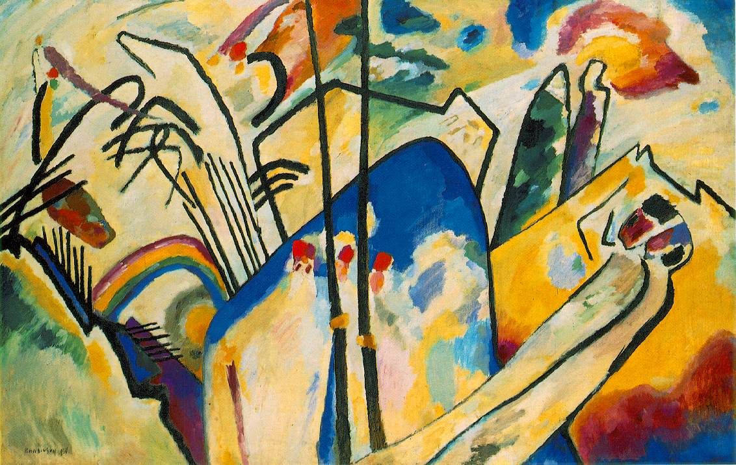
Composition 4

Slide 8
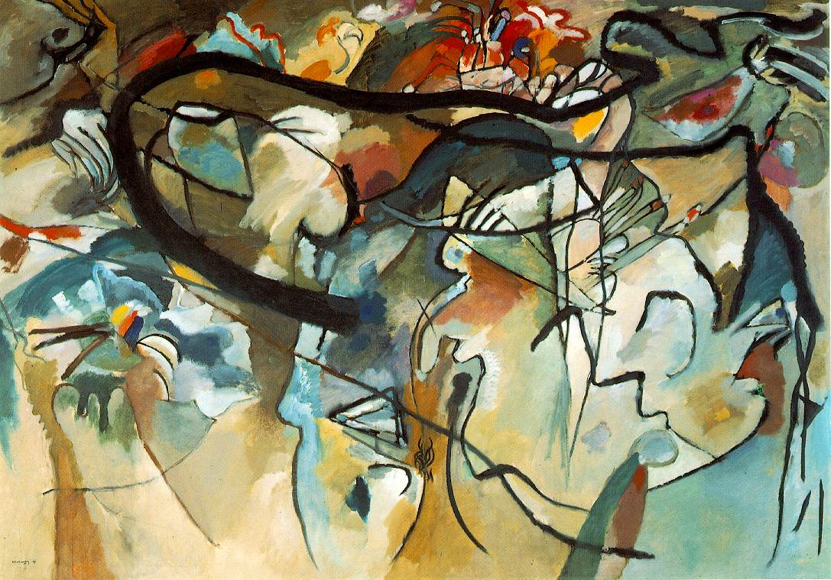
Composition 5

Slide 9
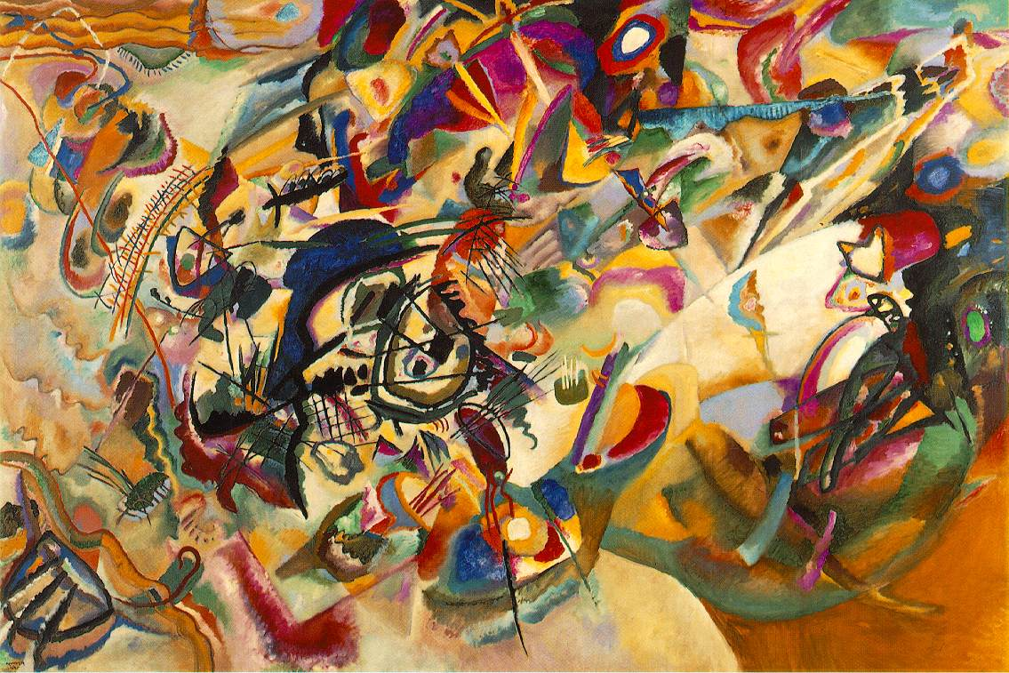
Composition7

Slide 10
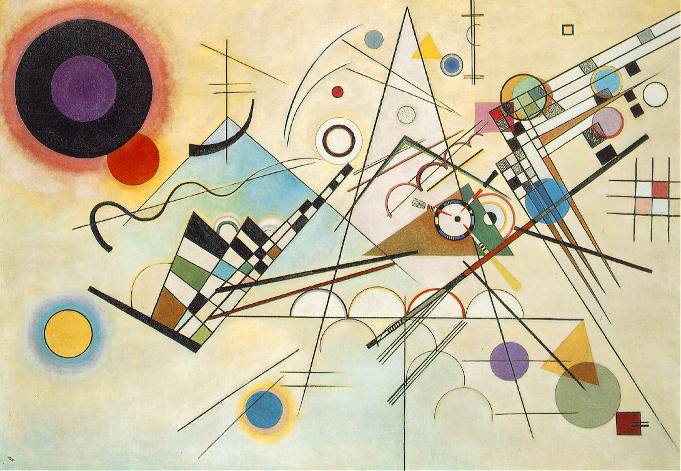
Composition 8

Slide 11
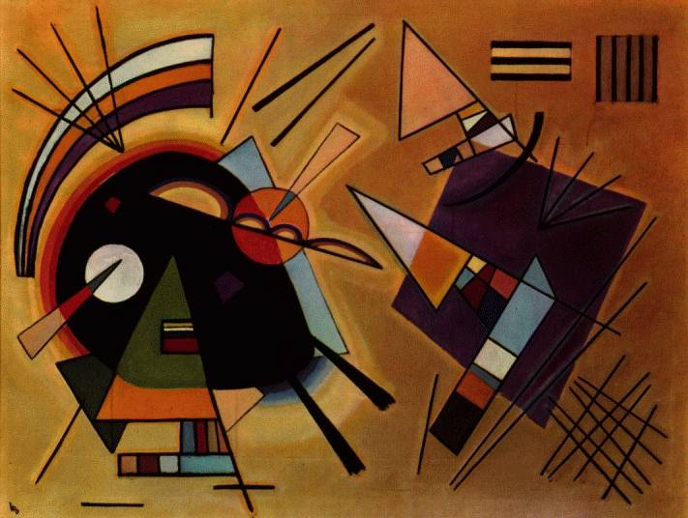
Black and Violet

Slide 12
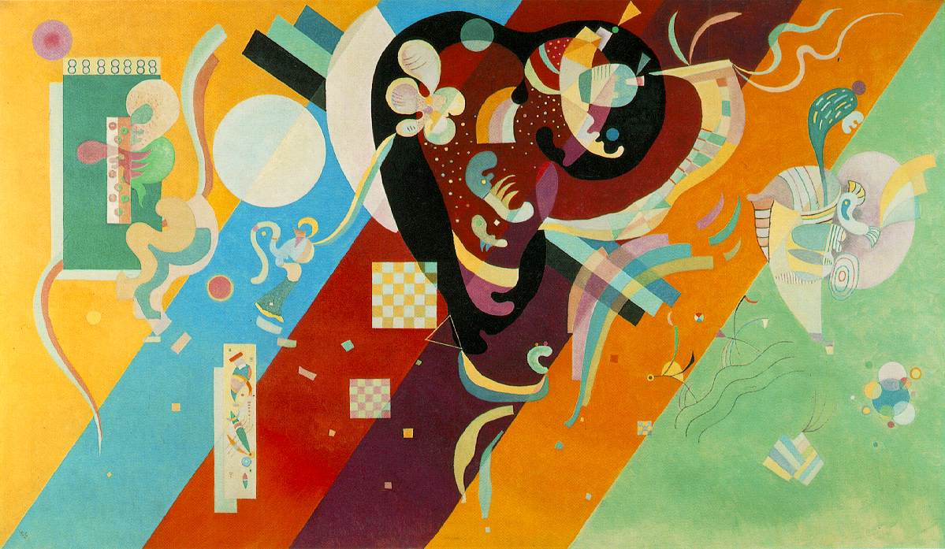
Composion 9

Slide 13
